Slide 1

Capstone Project
Thermal Insulator from Buffing Dust
Student ID
2011049
2011050
2011051
2011052
2011053 Md. Atik Faisal
2011054

Slide 2
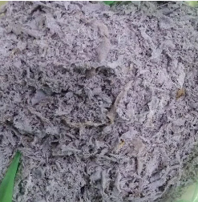
Thermal Insulator from Buffing Dust

Slide 3
Target:
To reuse the solid waste, Buffing Dust, produced from raw hide in tanning industries(approximately 20,000 to 35,000 Metric Ton per year in Bangladesh) which poses a serious environment risk

Slide 4
Materials:
Buffing Dust
Polystyrene/Polyester
Citric acid as blowing agent

Slide 5
Attempt 1:
Material Used:
Buffing Dust, Polystyrene Beads, Citric acid
Process
We experimented with various combinations of raw materials and tested different processing techniques.

Slide 6
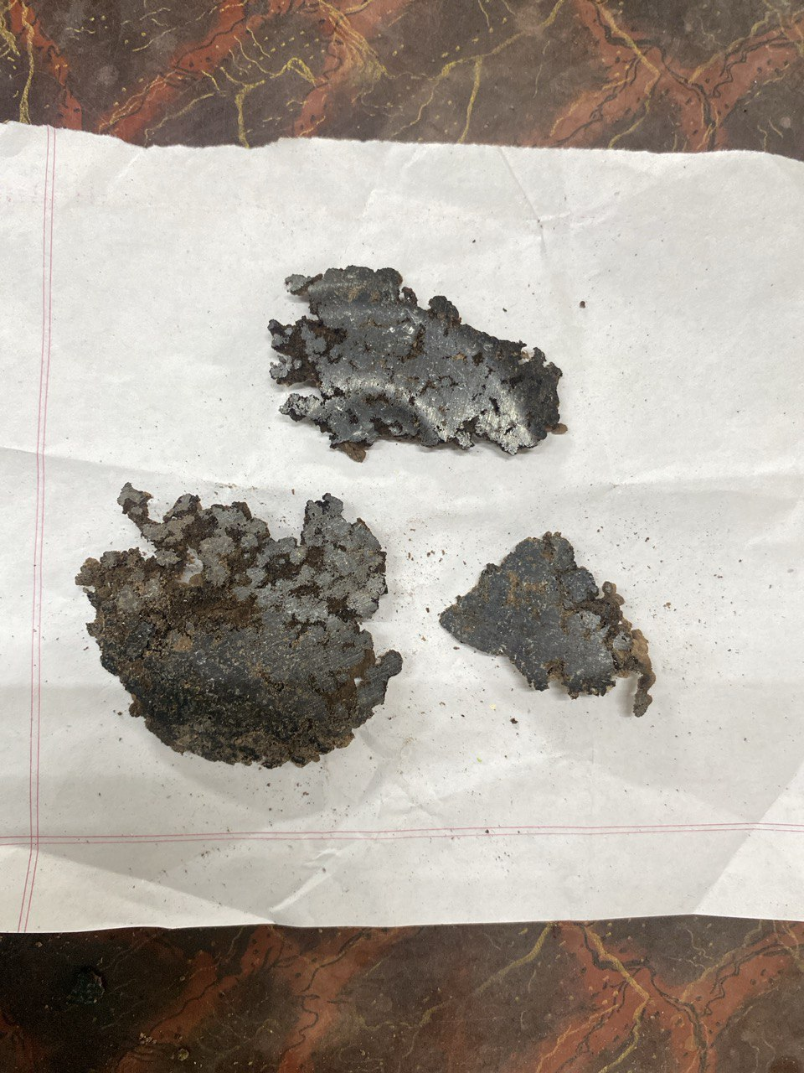
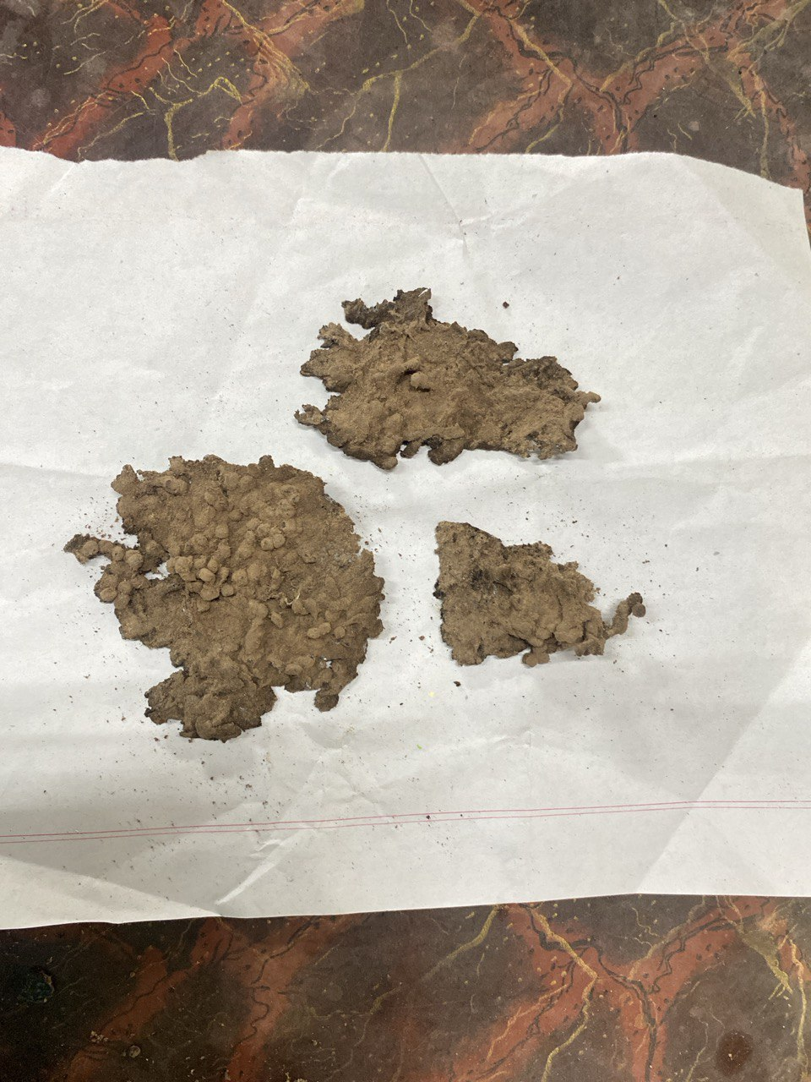
Attempt 1 Result:

Slide 7
Attempt 2:
Material Used:
Buffing Dust, Polystyrene Beads, Citric acid
Process
To enhance foaming, we increased the amount of citric acid. However, the high viscosity of molten polystyrene hindered uniform mixing. .

Slide 8
Attempt 3:
Material Used:
Buffing Dust, Polystyrene Beads, Citric acid
Process
To induce foaming, we had to apply high-pressure CO2. To address the foaming issue, we thought to heat the mixture in a furnace at about 600 degrees Celsius for the same raw material. We prepared two moulds for this process: a cylindrical mould and a cubic mould.

Slide 9
Attempt 4:
Material Used:
Buffing Dust, Polyester Resin, Citric acid, Hardener
Process
Realizing the limitations caused by polystyrene's high viscosity, we replaced polystyrene beads with resin to facilitate foaming. We experimented with various combinations of resin, buffing dust, and citric acid to achieve an optimal mixture. To increase the hardness of the sample, we added a hardener.

Slide 10
Attempt 5:
Material Used:
Buffing Dust, Polyester Resin, Citric acid, Hardener
Process
We prepared a cylindrical sample by mixing resin, buffing dust, and citric acid, heating it in a silicone-coated mold, and adding hardener for improved surface hardness before measuring thermal conductivity.
This is our latest attempt, and it showed good foaming and insulation during the thermal conductivity test.

Slide 11
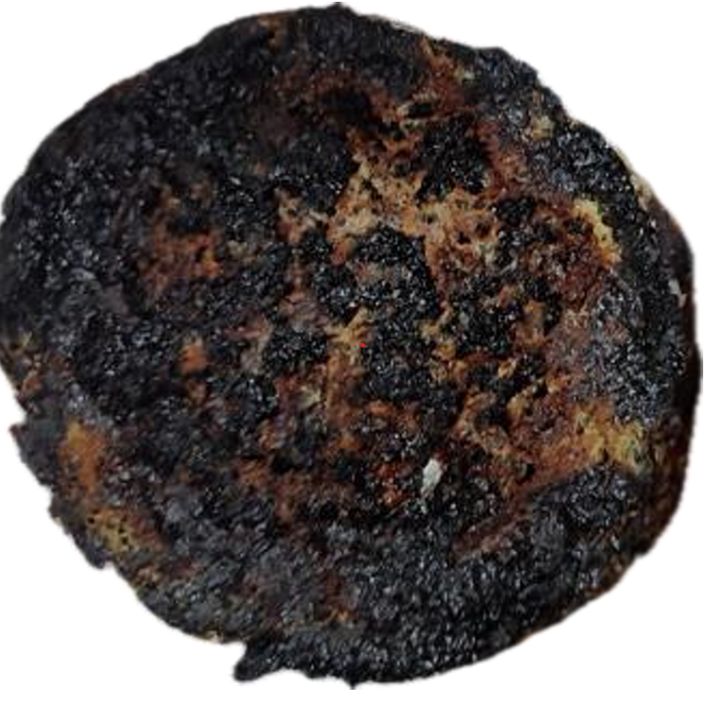
Attempt 5 Result:

Slide 12
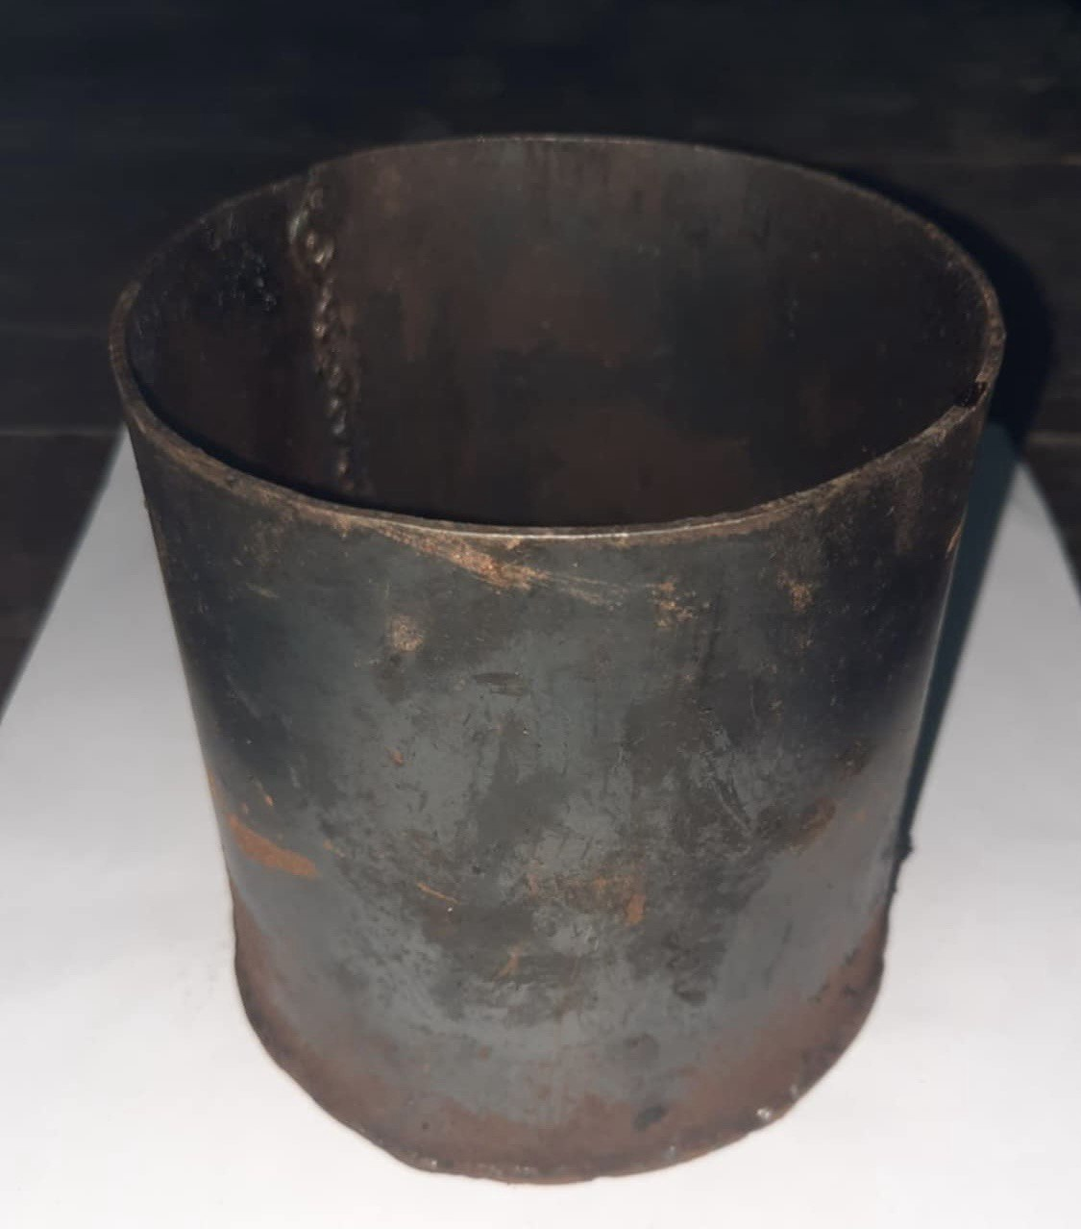
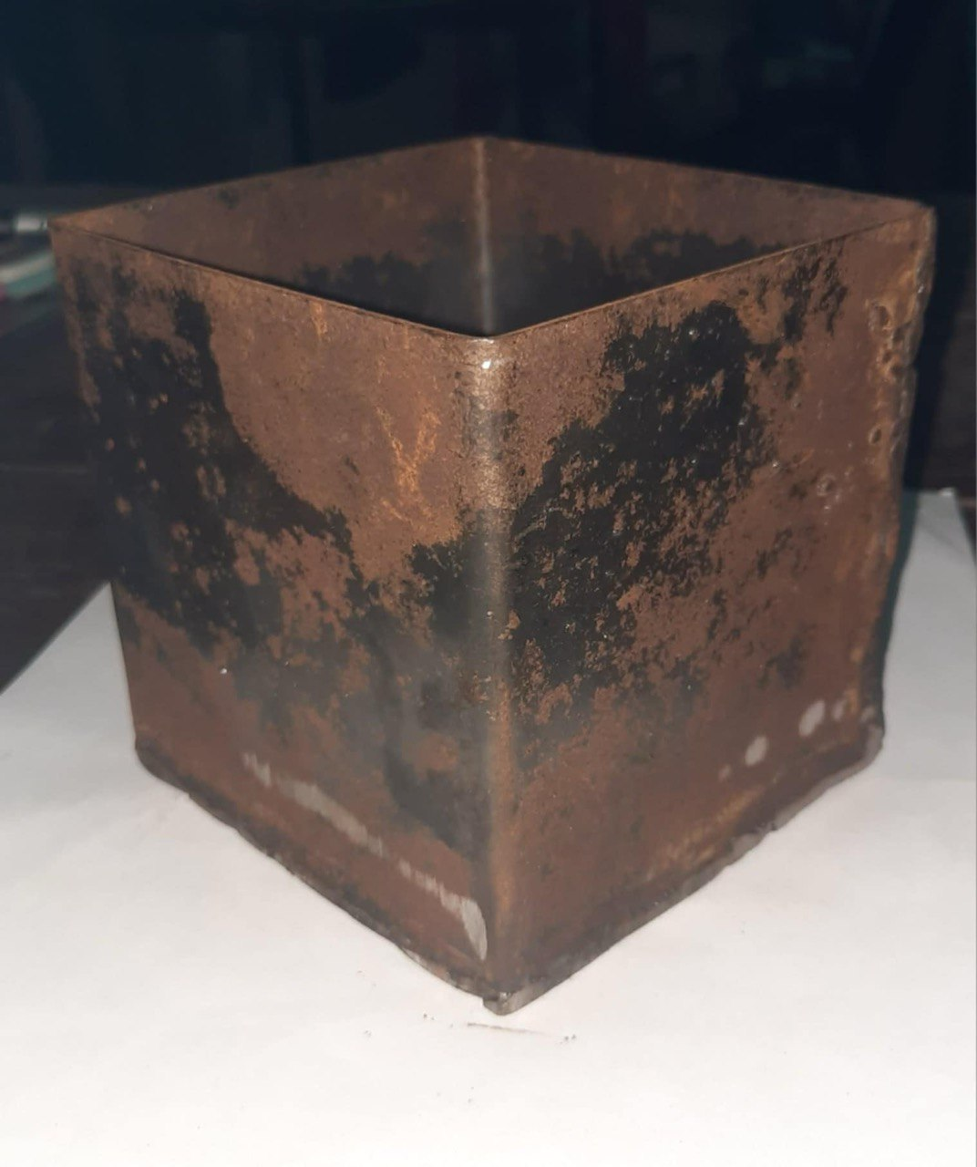
Moulds:
Two moulds were made using MS sheet:
Cylindrical - (Diameter : 3.9inch, Height: 4 ich)
Square - ( 4*4*4 cubic inch)

Slide 13
Tests to be conducted:
Thermal Conductivity
The test has already been conducted; it needs further calculation from the data to get the conductivity.
FTIR
The sample has been sent for FTIR analysis.
DSC
Due to the machine being out of order, currently we are unable to conduct the test; alternate options are being looked for.

Slide 14
Thank You

